Slide 1

Analysis of Top Streaming Music in Spotify
Data Engineering Platform for Analytics Final Project
Team 2:
Harsha Muthukuru, Jieyu Zhang, Pengran Xu,
Sai Krishna Jasti, Yif Wang, Yuze Zhang
Notes:
yif

Slide 2
Agenda
Executive Summary
Business Case
Data Modeling
Data Profiling
Insights and Recommendations
Lessons Learned
Reference
Notes:
yif

Slide 3
Executive Summary
The music industry is ever changing with new artists and musicians coming to fame frequently. Spotify and the music studios want to analyze the trends in the songs at a weekly level to identify the regional and global reach of the singers/composers. This project will analyze the popularity of the artist and the trends in music around the world.
Notes:
-yif

Slide 4
Business Case
Spotify wants to analyze the regional and global popularity of the songs on its platform.
Detailed analysis of the Spotify Streaming data will:
Let Spotify know which songs to recommend to others based on their language, artis, genre, or region preference
Allow music studios aid their recruitment processes of singer and composers
and, it can help the music amateurs explore artists and music trends around the world. These will be accomplished by the analysis
Notes:
yif

Slide 5



Data Preparation
Technology used:
Data Collection
Data
Discovery
Data
Cleaning
Data Transformation
Data Integration
Ingest data from kaggle into csv files for further
processing
Identifies patterns, relationships and
other attributes in the data, as well
as missing values, inconsistencies, and
anomalies
Extract only the columns we need and reduce data to only contain data of 2022. Convert the data types as required.
Create new fields or columns that
aggregate values from existing ones
Normalization,
create EER Model and connect
datasets using SQL
Notes:
Jieyu

Slide 6
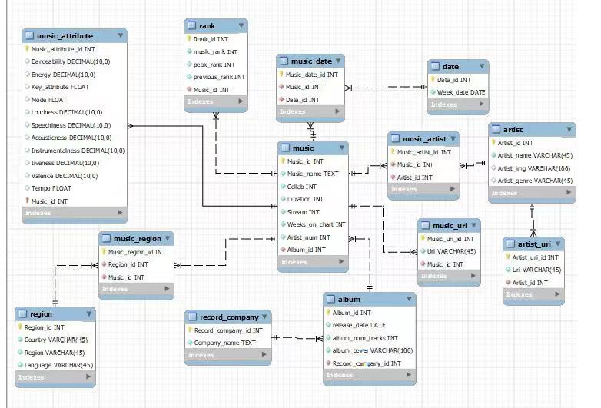
Data Models: Normalized Model
Notes:
pengran

Slide 7
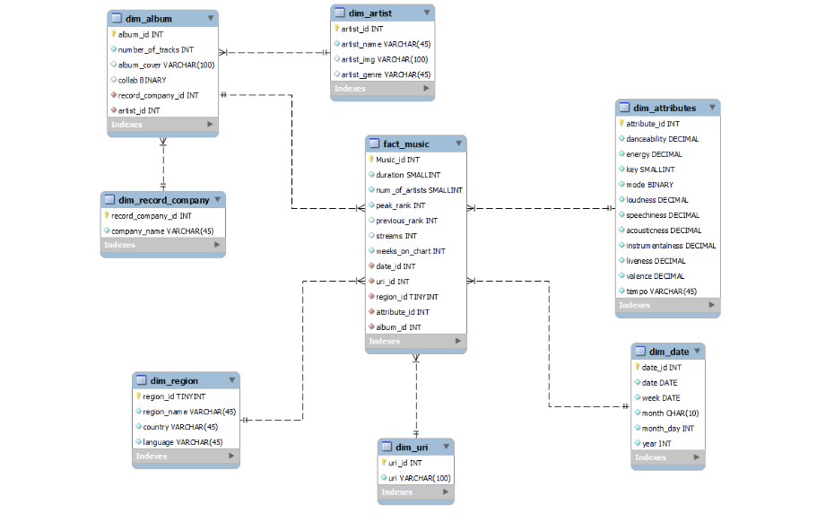
Data Models: Dimensional Model
Notes:
pengran

Slide 8
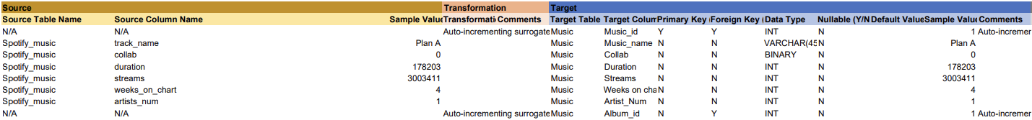
Platform Design Document: Source to Target Mapping
The team completed STM on target tables: Spotify_music, Music_attribute, Artist, Artist_genre, Album, Record_company, Date, Region, Rank, Music_has_multiple_artist, Artist_uri and Music_uri
Example of STM on Spotify_music:
Notes:
Jason Zhang

Slide 9
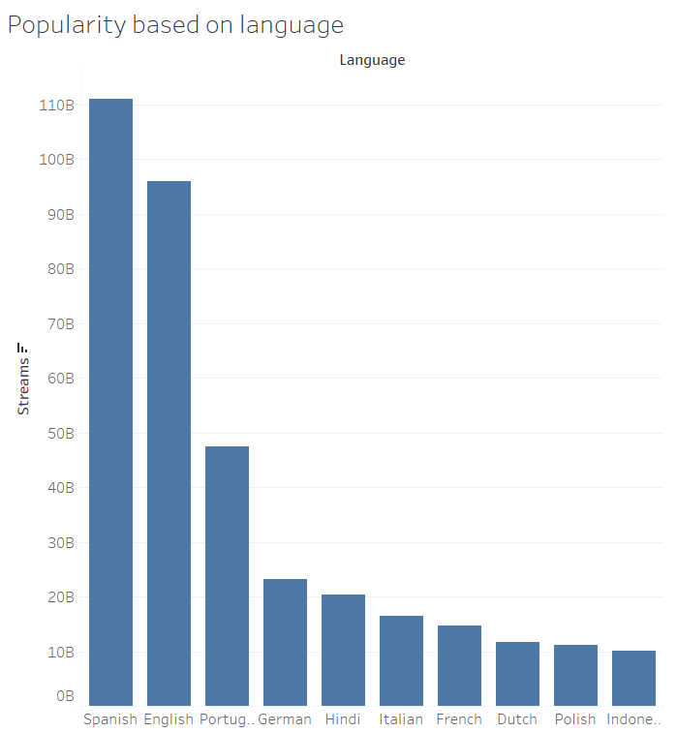
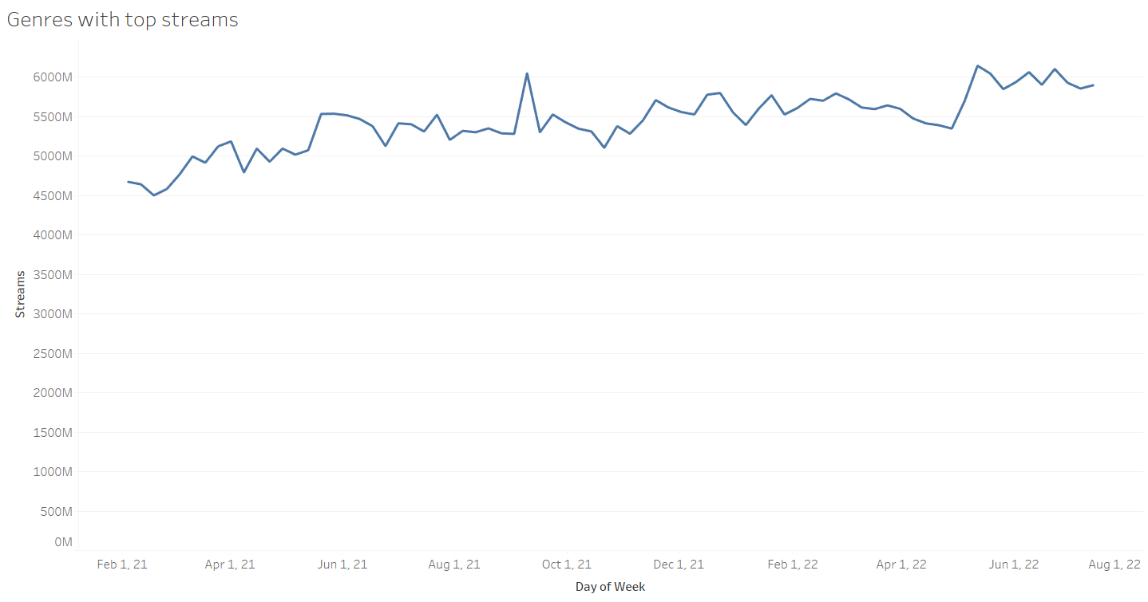
Data Profiling- EDA
Most listened language - Spanish
Consistent yearly growth of streams on the platform

Slide 10
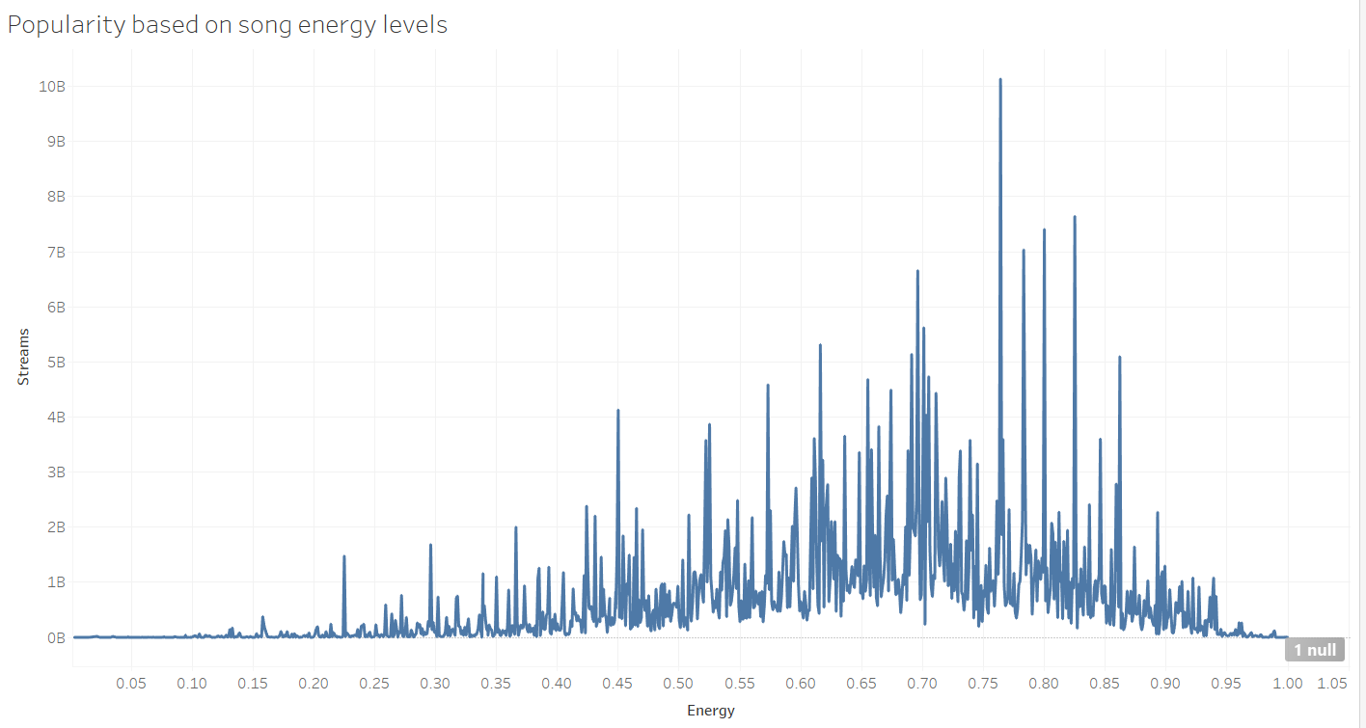
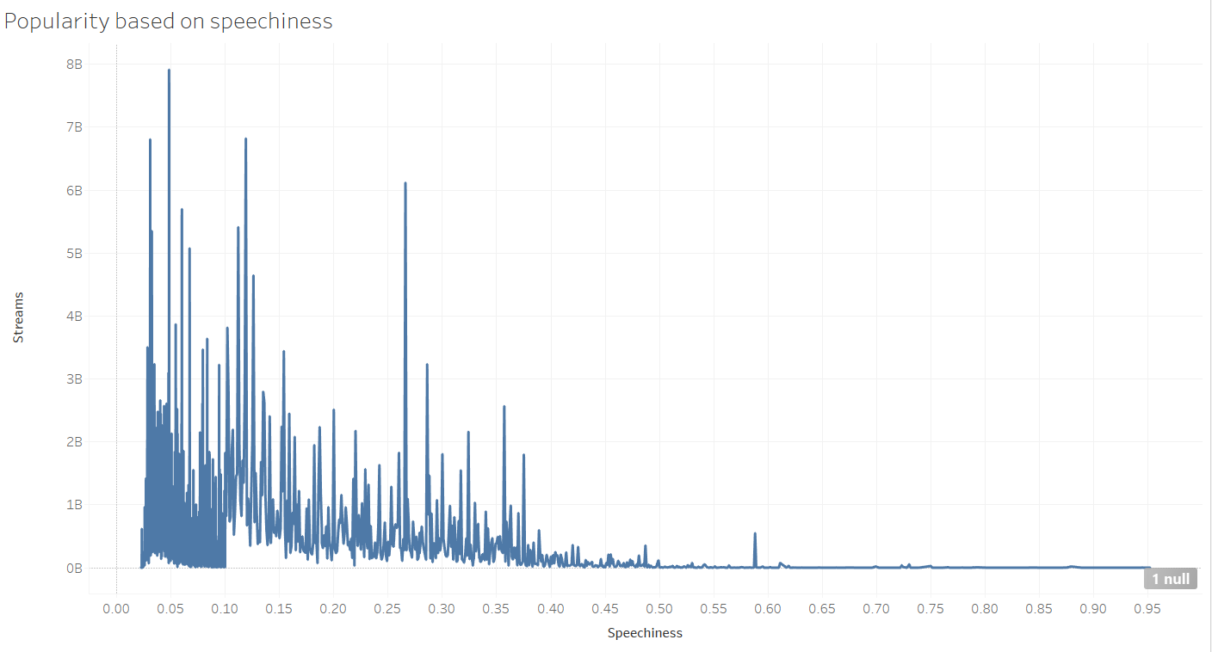
Data Profiling- EDA
Intuitively, songs with optimal energy levels and low speech content are more popular.

Slide 11
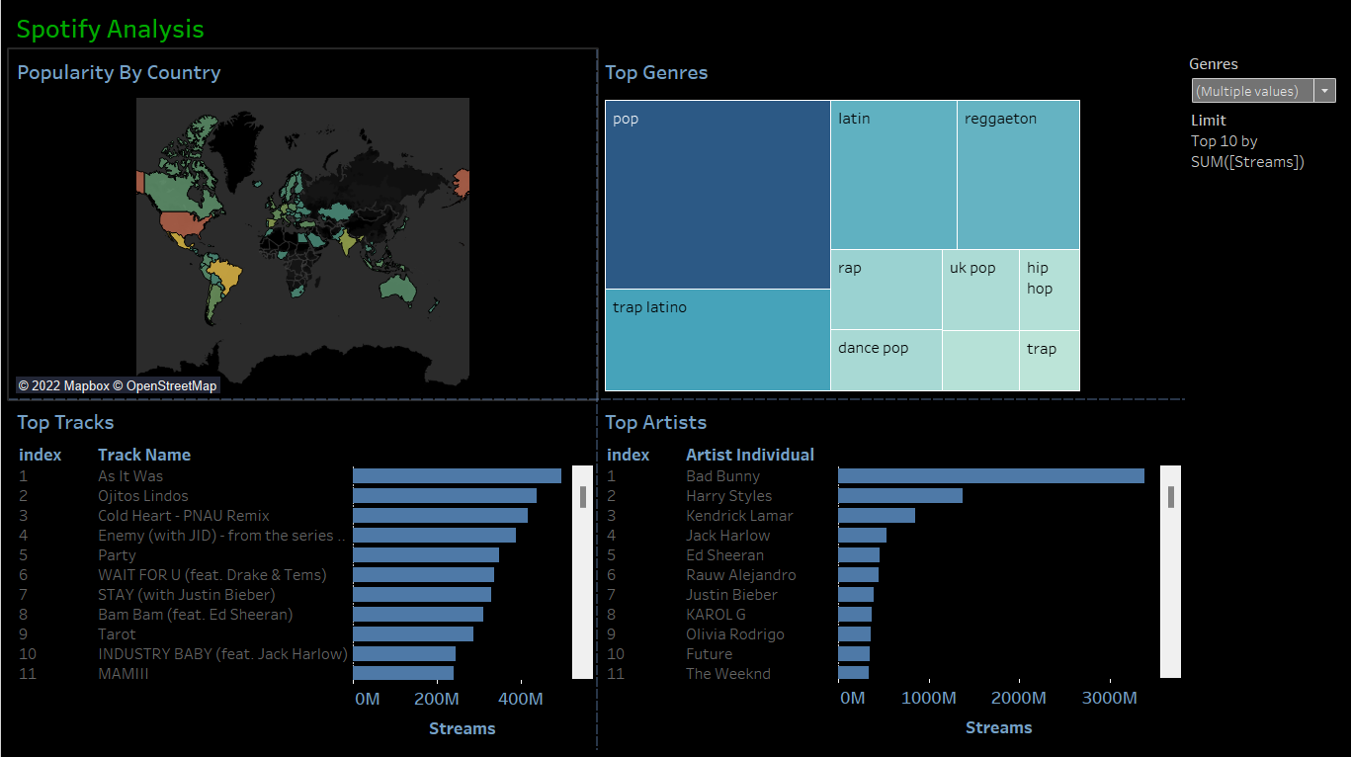
Insights - Data Visualization & BI

Slide 12
Challenges Faced & Potential Future Solutions
Challenge:
Data has regional language characters which made us difficult to load the data to SQL
We were not able to load our entire data to SQL as the data is huge and is consuming time
Future Solutions:
Use C/C++ to write pre-processors for data cleansing
Build project on cloud platforms like AWS, GCP, Azure to save time
Connecting with Spotify API from Tableau to get real-time insights

Slide 13
Lessons Learned
Acquire datasets that aligns with business needs
Data cleaning and re-formatting
ETL process including data extraction, transformation, and loading tasks
Story-Telling and Data Visualization
Team Collaboration and Delivering results

Slide 14
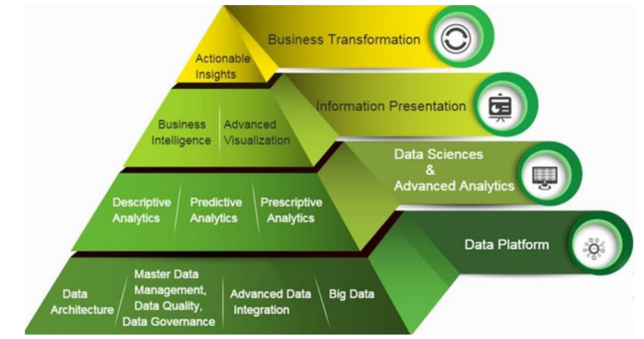
Lessons Learned
Data Engineering is the foundation for analytics and actionable business insights

Slide 15
References
Data : https://www.kaggle.com/datasets/yelexa/spotify200
Web Scraping Ref: https://gist.github.com/hktosun/d4f98488cb8f005214acd12296506f48
Ideology and Approach: https://medium.com/analytics-vidhya/visualizing-spotify-top-200-data-in-tableau-implementing-a-fast-python-web-scraper-88a562495ad8
Spotify Developer Dashboard:
https://developer.spotify.com/dashboard/
Spotify Charts Data: https://charts.spotify.com/charts/overview/ar
Dataset of our project: https://uchicagoedu-my.sharepoint.com/:f:/g/personal/harshamuthukuru_uchicago_edu/EoSI6j0UtNJPlHV1q4hwVAYBTfwnE9MBD2m1T0YKobKL6A?e=Yue9qC

Slide 16
Appendix: Data Collection and Preparation
Technology used:
Data Preparation:
Data Collection
Data Preparation
Data Source: Kaggle
Country level data was taken from spotify charts and used the spotify API to gather other audio features of each track
Extract only the columns we need
Reduce data to only contain data of 2022
Normalization
Replace missing value with ‘null’
Update to proper data types

